Slide 1
FACULTY OF ENGINEERING AND TECHNOLOGY DEPARTMENT OF COMPUTER ENGINEERING SOFTWARE ENGINEERING CEF440: Internet and Mobile Programming DESIGN AND IMPLEMENTATION OF A DATABSE FOR A DISASTER MANAGEMENT MOBILE APPLICATION

Slide 2
Presented By:
Group 2
NAMES | MATRICULE
QUINUEL TABOT NDIP-AGBOR | FE21A300
SIRRI THERESIA ANYE | FE21A306
NGONCHI RAMATOU YOLAND | FE21A260
CHE BLAISE NJI | FE21A157
LIMA CHARLES | FE21A225
Course Instructor:
Dr. NKEMENI Valery, PhD

Slide 3
Outline
01
Introduction
02
Implementation
03
Conclusion

Slide 4
Introduction
In this phase, we will design and implement a database for a disaster management system using Firebase Firestore. Our system is intended to manage various types of data, including user profiles, emergency responder contacts, real-time alerts, incident reports, locations, language preferences, and preparedness resources.

Slide 5
Implementation
Breakdown of Project Scope
Conceptual Design
Results
DISASTER
MANAGEMENT

Slide 6
Breakdown Of Project Scope
1) User Registration and Authentication 2) Entities and Relationships 3) Functionality

Slide 7
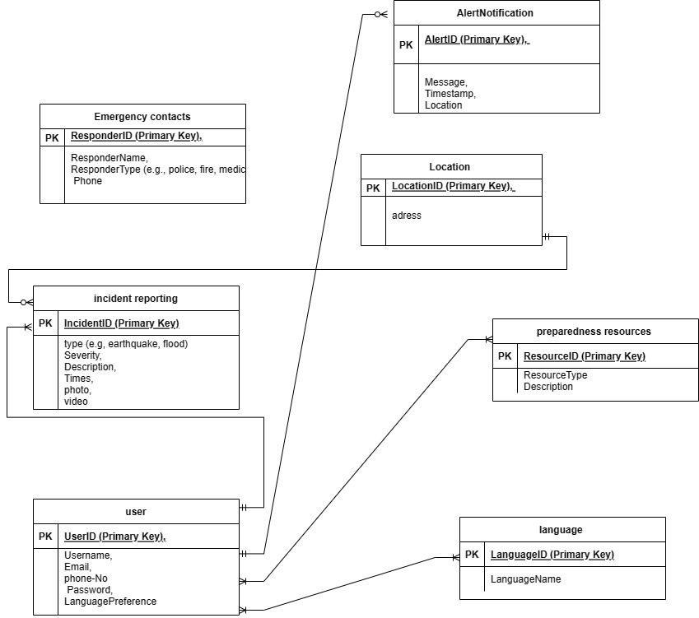
2) Conceptual Design

Slide 8
Firebase Realtime Database
Firebase is a cloud-based platform that offers a suite of services for mobile and web app development. One of its key components is the Firebase Realtime Database, which is a NoSQL database that provides real-time data synchronization.
Firebase Realtime Database provides a powerful, flexible, and easy-to-use NoSQL database with real-time data synchronization, making it ideal for building modern mobile and web applications that require instant data updates and seamless user experiences

Slide 9
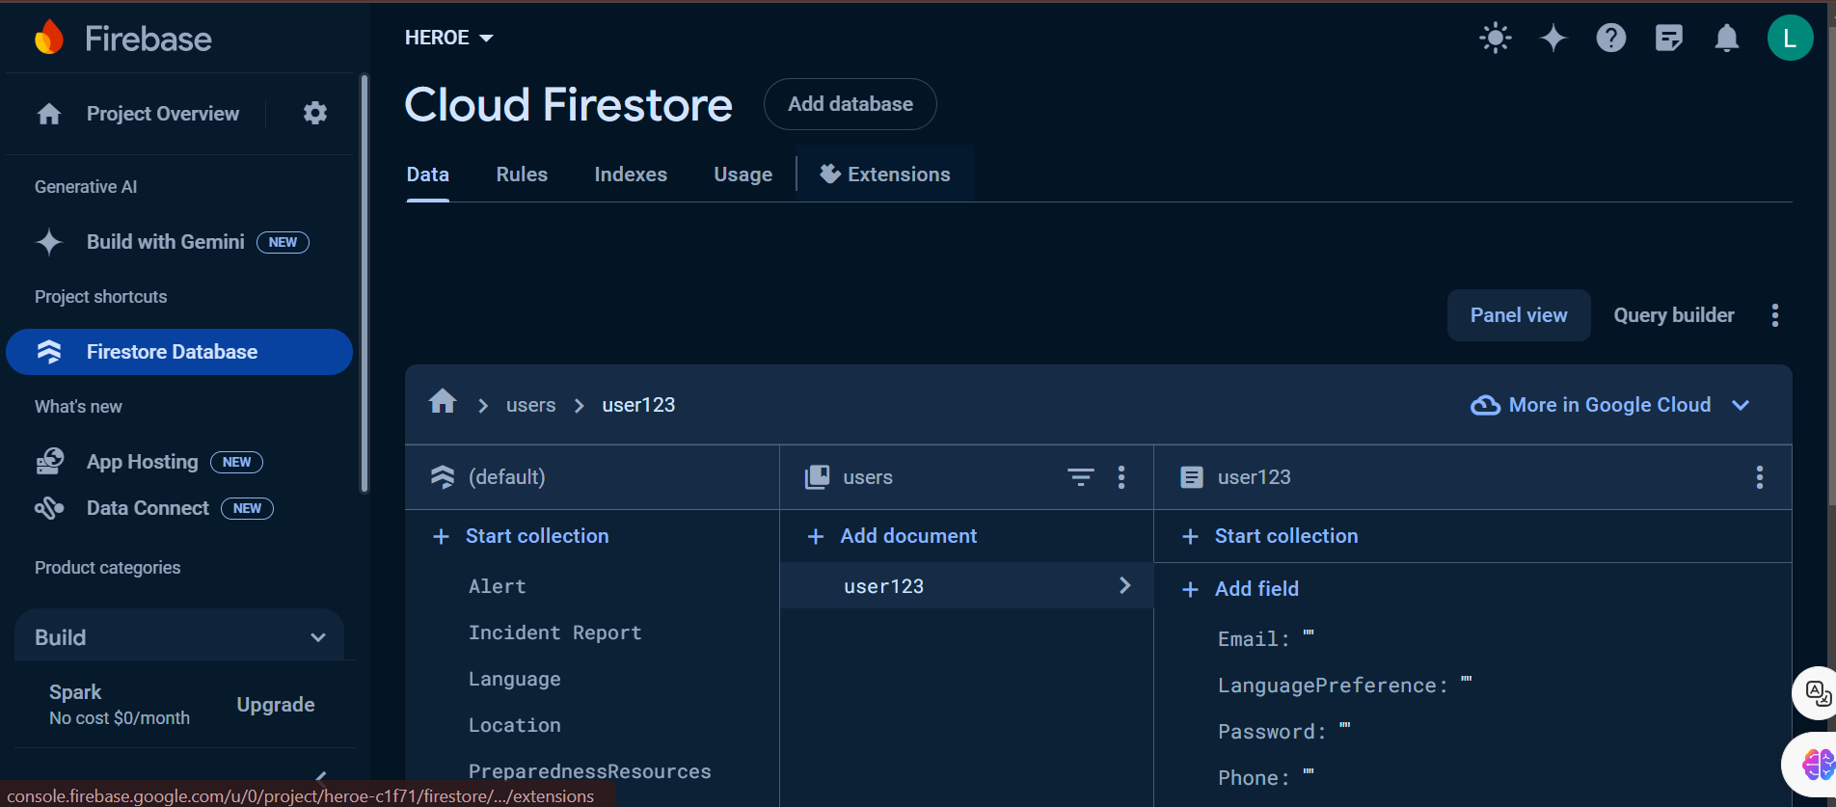
Results
1) Collection and Document

Slide 10
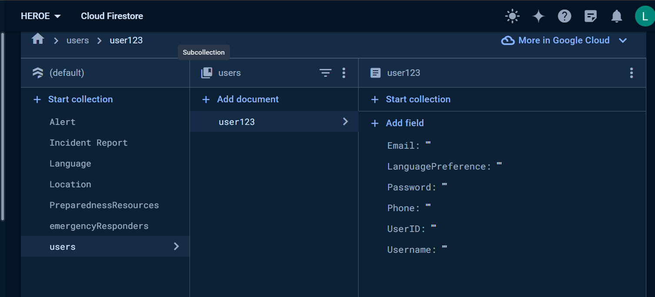
2) User/Admin
2) User/Admin

Slide 11
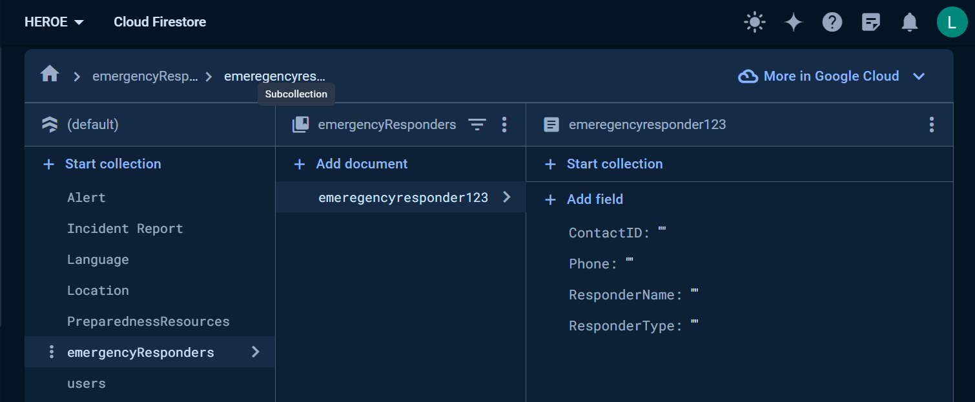
3) Emergency CorrespondersAccuracy and Reliability of Geospatial Data:
Accessibility of the Application:

Slide 12
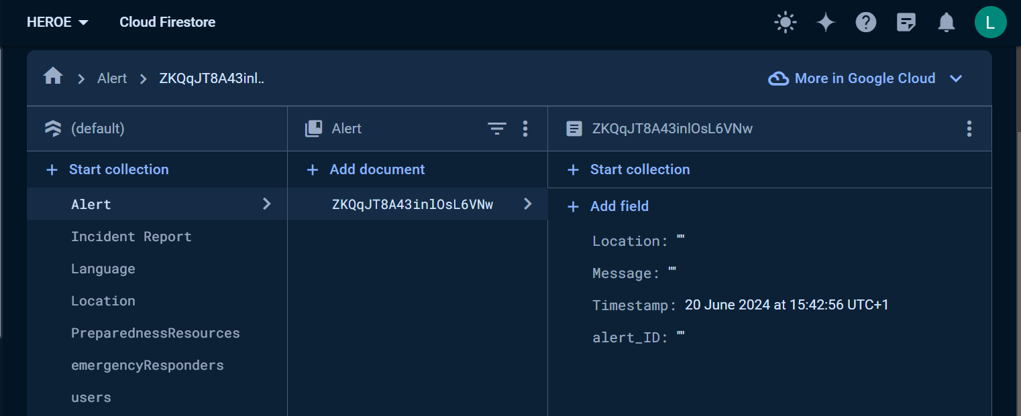
3) Alerts/ NotificationsEQUIREMENTS
Streamlined Coordination Between Emergency Responders
Information Sharing Among Users and Stakeholders
Centralized Repository of Emergency Contact Information

Slide 13
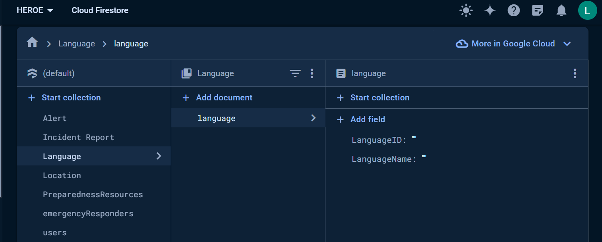
STAKEHOLDERS AND USER REQUIREMENTS
5) Language CollectionSTAKEHOLDERS
Government Agencies
Non-Profit Organizations
Emergency Responders (Fire Department/ Police)
Users (General Public)

Slide 14
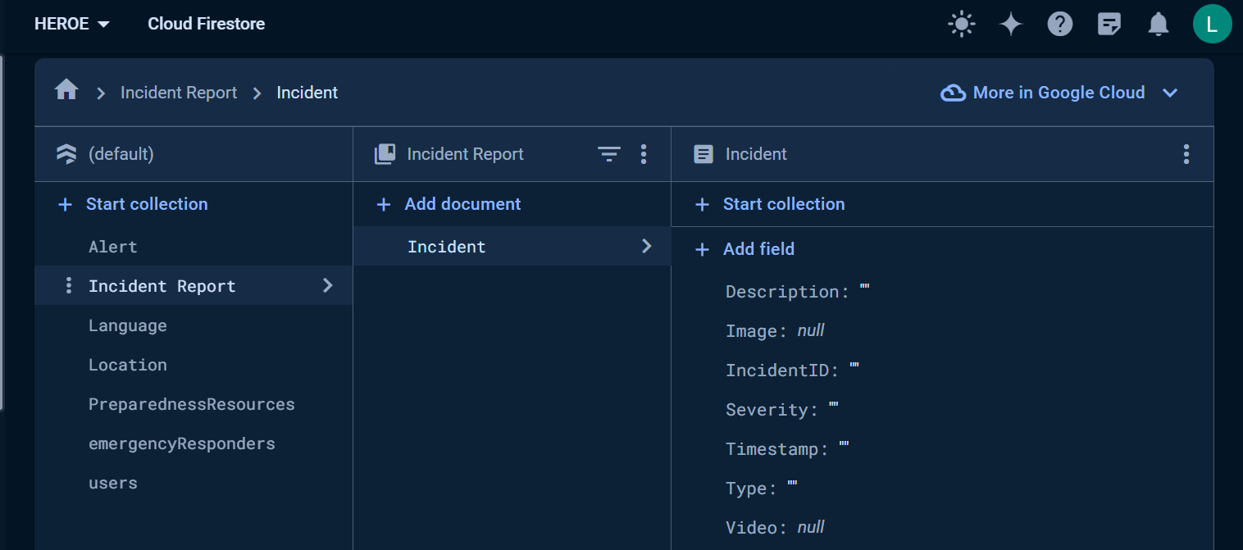
6) Incident Report CollectionsSTAKEHOLDERS

Slide 15
Conclusion
This report provides a detailed database design and implementation for a disaster management mobile application using Firebase Firestore. The design includes well-defined entities, attributes, and relationships, mapped effectively to Firestore collections and documents. This structure ensures efficient data management and real-time capabilities essential for a disaster management application.

Slide 16
Thank You
For Your
Keen Attention
Disaster
Management

